Slide 1
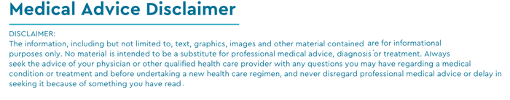
Dia-Scaler
By Niels de Haan, Marc Pocorni and Jason Steiner.
The tool to help keep you diabetes free!

Slide 2
Executive Summary
What is it?
The Dia-Scaler is a tool that calculates a users risk of contracting diabetes. The user inputs: age, glucose, insulin, BMI, blood pressure, skin thickness, and diabetes pedigree function, and the tool determines a low, moderate or high risk classification.
How?
The Dia-Scaler is fed by a medical database which consists of anonymized data of patients tested for diabetes. The tool trains on this data to correlate features and output to make an outcome prediction based on numerous machine learning techniques.
Why?
A diabetes diagnosis increases medical expenses by 230% on average. 25% of healthcare expenditures in the US are due to diabetes. The Dia-Scaler can be used as a preventive tool, identifying high risk individuals in an effort to direct preventative measures.

Slide 3
Data Techniques
https://www.kaggle.com/datasets/uciml/pima-indians-diabetes-database
Source for diabetically tested people
Collection, exploration and cleaning process, done through streamlit.

Slide 4
Approach
Tech used: Python, Pandas, Numpy, Pathlib, Streamlit, Tensorflow, Sklearn, imblearn, seaborn, matloplotlib, and os.
Breakdown of Tasks:
Marc: Predictions, insurance cost calculator,PPT,app testing.
Jason: Recommendations, risk and model evaluation, description, README, app testing
Niels: App development, App testing, NN setup, Data Enhancement Techniques
Obstacles: Learning to work with Streamlit, working with medical data, analysis of feature relevance
Success: Teamwork - Working in Streamlit certainly brought its challenges especially when integrating our codes, however good communication,patience, and understanding aided us to conquer these obstacles.

Slide 5
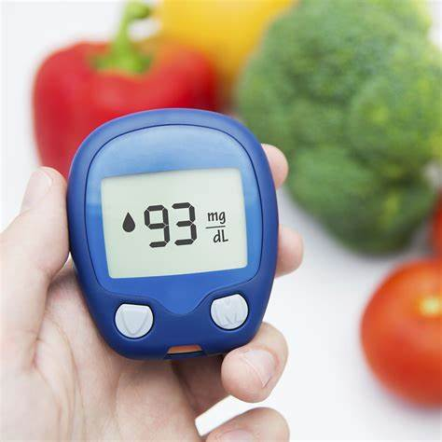

Example User: Bobby McBobbins
Age: 45
BMI: 40 kg/m^2
Glucose: 120 mg/dL
Insulin: 80 uU/mL
Diastolic blood pressure: 120 mm Hg
Diabetes pedigree function: 0.574
Skin thickness: 30 mm

Slide 6

Demo

Slide 7
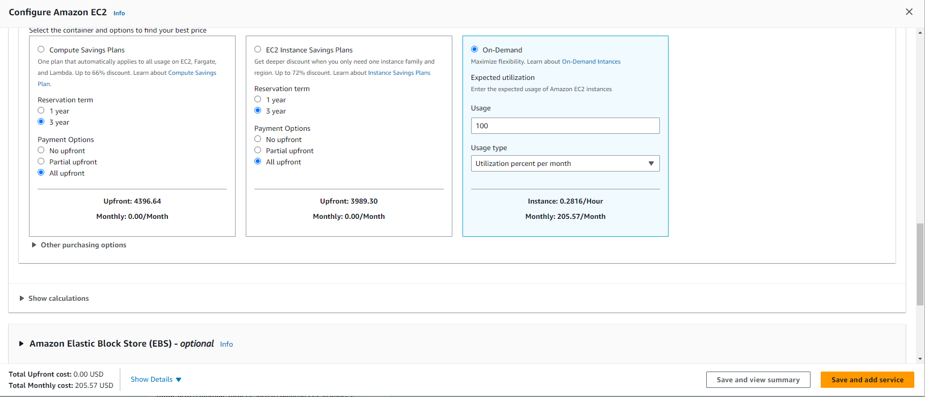
AWS Estimated costs

Slide 8
Next Steps
Additional questions which surfaced: Since 1 in 4 dollars spent in healthcare goes to diabetics, how do insurance companies, factor in high med and low risk individuals?
Additional topics to research: Which factors are key for diabetics, and their correlation to one another.
Plans for future development:
Smoothing out streamlit kinks, such as the continuous reloading of the models.
Seek consultation from a medical expert/acquire more complete medical data
Since the Dia-scaler is a preventive tool, giving smart-tips and applicable links for maintaining a healthy lifestyle should be incorporated in the future.
Explore how to implement split model and predictions/recommendations. Where model, and model performance are centrally managed which has the benefit that data is contained at 1 location and only the actual model is on AWS to help increase cyber security.

Slide 9
Link to Application
GitHub repository: nielsdehaan1977/Fintech_Project2 (github.com)

Slide 10
References
https://www.kaggle.com/datasets/uciml/pima-indians-diabetes-database
https://diabetesjournals.org/care/article/41/5/929/36592/The-Cost-of-Diabetes-Care-An-Elephant-in-the-Room
Batch Input Widgets | Introducing Submit Button & Forms (streamlit.io)

